Slide 1

Project Management
3
Kendall & Kendall
Systems Analysis and Design, 9e

Slide 2
Learning Objectives
Understand how projects are initiated and selected, define a business problem, and determine the feasibility of a proposed project.
Evaluate hardware and software and the way it supports human interactions with technology.
Forecast and analyze tangible and intangible costs and benefits.
Manage a project by preparing a budget, creating a work breakdown structure, scheduling activities, and controlling the schedule and costs.
Build and manage a project team
Professionally write and present an effective systems proposal, concentrating on both content and design
3-<number>

Slide 3
Project Management Fundamentals
Project initiation
Determining project feasibility
Activity planning and control
Project scheduling
Managing systems analysis team members
3-<number>
Notes:
Project initiation—begins with problems or with opportunities for improvement in a business as the organization adapts to change.
Determining project feasibility—need to work with decision makers to determine if it is feasible.
Project scheduling—project activities are scheduled through the use of tools such as Gantt charts and PERT diagrams.
Planning and managing activities and team members—part of assuring the productivity of systems analysis team members is effectively managing scheduled activities.

Slide 4
Project Initiation
Problems in the organization
  Problems that lend themselves to systems solutions
Opportunities for improvement
  Caused through upgrading, altering, or installing new systems
3-<number>
Notes:
Both problems and opportunities can arise as the organization adapts to and copes with natural, evolutionary change.

Slide 5
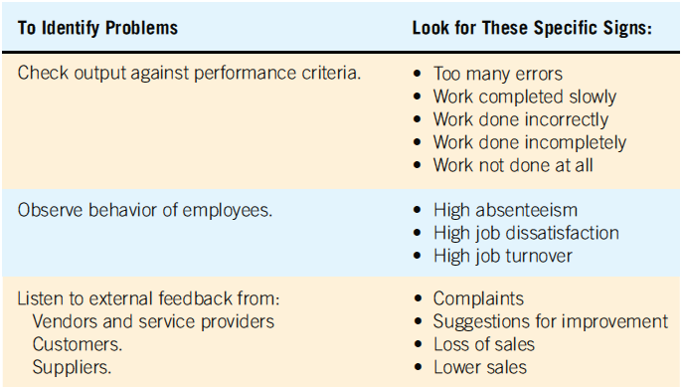
Checking Output, Observing Employee Behavior, and Listening to Feedback Are All Ways to Help the Analyst Pinpoint Systems Problems and Opportunities (Figure 3.1)
3-<number>

Slide 6
Problem Definition
Problem statement
  Paragraph or two stating the problem or opportunity
Issues
  Independent pieces pertaining to the problem or opportunity
Objectives
  Goals that match the issues point-by-point
Requirements
  The things that must be accomplished along with the possible solutions, and constraints, that limit the development of the system
Use the problem definition to create a preliminary test plan
3-<number>
Notes:
Issues are the current situation, objectives are the desired situation.
Requirements may include security, usability, government requirements and so on.
Constraints might be budget restrictions or time limitations.

Slide 7
Problem Definition Steps
Find a number of points that may be included in one issue
State the objective
Determine the relative importance of the issues or objectives
Identify which objectives are most critical.
3-<number>
Notes:
Before the problem definition is produced information is gathered from interviews, observations, and document analysis with the users. Major points are then identified as issues.
Once the issues are identified (current situation), objectives are stated (desired situation). Sometimes this may require follow-up interviews.
After the objectives are stated the relative importance of the issues or objectives is determined.
Due to constraints it is generally necessary to order the objectives to determine which are most critical.

Slide 8
Selection Of Projects
Backing from management
Appropriate timing of project commitment
Possibility of improving attainment of organizational goals
Practical in terms of resources for the system analyst and organization
Worthwhile project compared with other ways the organization could invest resources
3-<number>
Notes:
Backing from management—absolutely nothing can be accomplished without the endorsement of the people who eventually will foot the bill.
Appropriate timing of project commitment—can a time commitment be made for installation of new systems or improvement to existing ones.
Possibility of improving attainment of organizational goals—the project should put the organization on target, not deter it from its goals.
Practical in terms of resources for the system analyst and organization—is there expertise and resources to carry out the project.
Worthwhile project compared with other ways the organization could invest resources—when a business commits to one project it is committing resources that are unavailable for other projects.

Slide 9
Selection of Projects: Improving Attainment of Organizational Goals
Improving corporate profits
Supporting the competitive strategy of the organization
Improving cooperation with vendors and partners
Improving internal operations support
Improving internal decision support so that decisions are more effective
Improving customer service
Increasing employee morale
3-<number>

Slide 10
Defining Objectives
Many possible objectives exist including:
  Speeding up a process
  Streamlining a process
  Combining processes
  Reducing errors in input
  Reducing redundant storage
  Reducing redundant output
  Improving system and subsystem integration
3-<number>
Notes:
Improvements to systems can be defined as changes that will result in incremental but worthwhile benefits.

Slide 11
Determining Feasibility
Defining objectives
Determining resources
  Operationally
  Technically
  Economically
3-<number>
Notes:
The feasibility study must be highly time compressed, encompassing several activities in a short span of time.

Slide 12
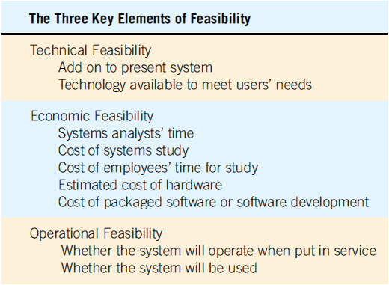
The Three Key Elements of Feasibility Include Technical, Economic, and Operational Feasibility (Figure 3.3)
3-<number>
Notes:
A project must be feasible in all three ways to merit further development.

Slide 13
Technical Feasibility
Can current technical resources be upgraded or added to in a manner that fulfills the request under consideration?
If not, is there technology in existence that meets the specifications?
3-<number>
Notes:
Sometimes add-ons are costly and not worthwhile, because they meet needs inefficiently.

Slide 14
Economic Feasibility
Economic feasibility determines whether value of the investment exceeds the time and cost
Includes:
  Analyst and analyst team time
  Business employee time
  Hardware
  Software
  Software development
3-<number>
Notes:
If short-term costs are not overshadowed by long-term gains or produce no immediate reduction in operating costs, the system is not economically feasible.

Slide 15
Operational Feasibility
Operational feasibility determines if the human resources are available to operate the system once it has been installed
Users that do not want a new system may prevent it from becoming operationally feasible
3-<number>
Notes:
If users are satisfied with current system resistance to implementing a new system will be strong.
If users are dissatisfied with the current system and have expressed a need for change chances are that the new system will be used.

Slide 16
Estimating Workloads
Systems analysts formulate numbers that represent both current and projected workloads for the system so that any hardware obtained will possess the capability to handle current and future workloads
3-<number>
Notes:
The newly-proposed system should cut down required human and computer time.

Slide 17
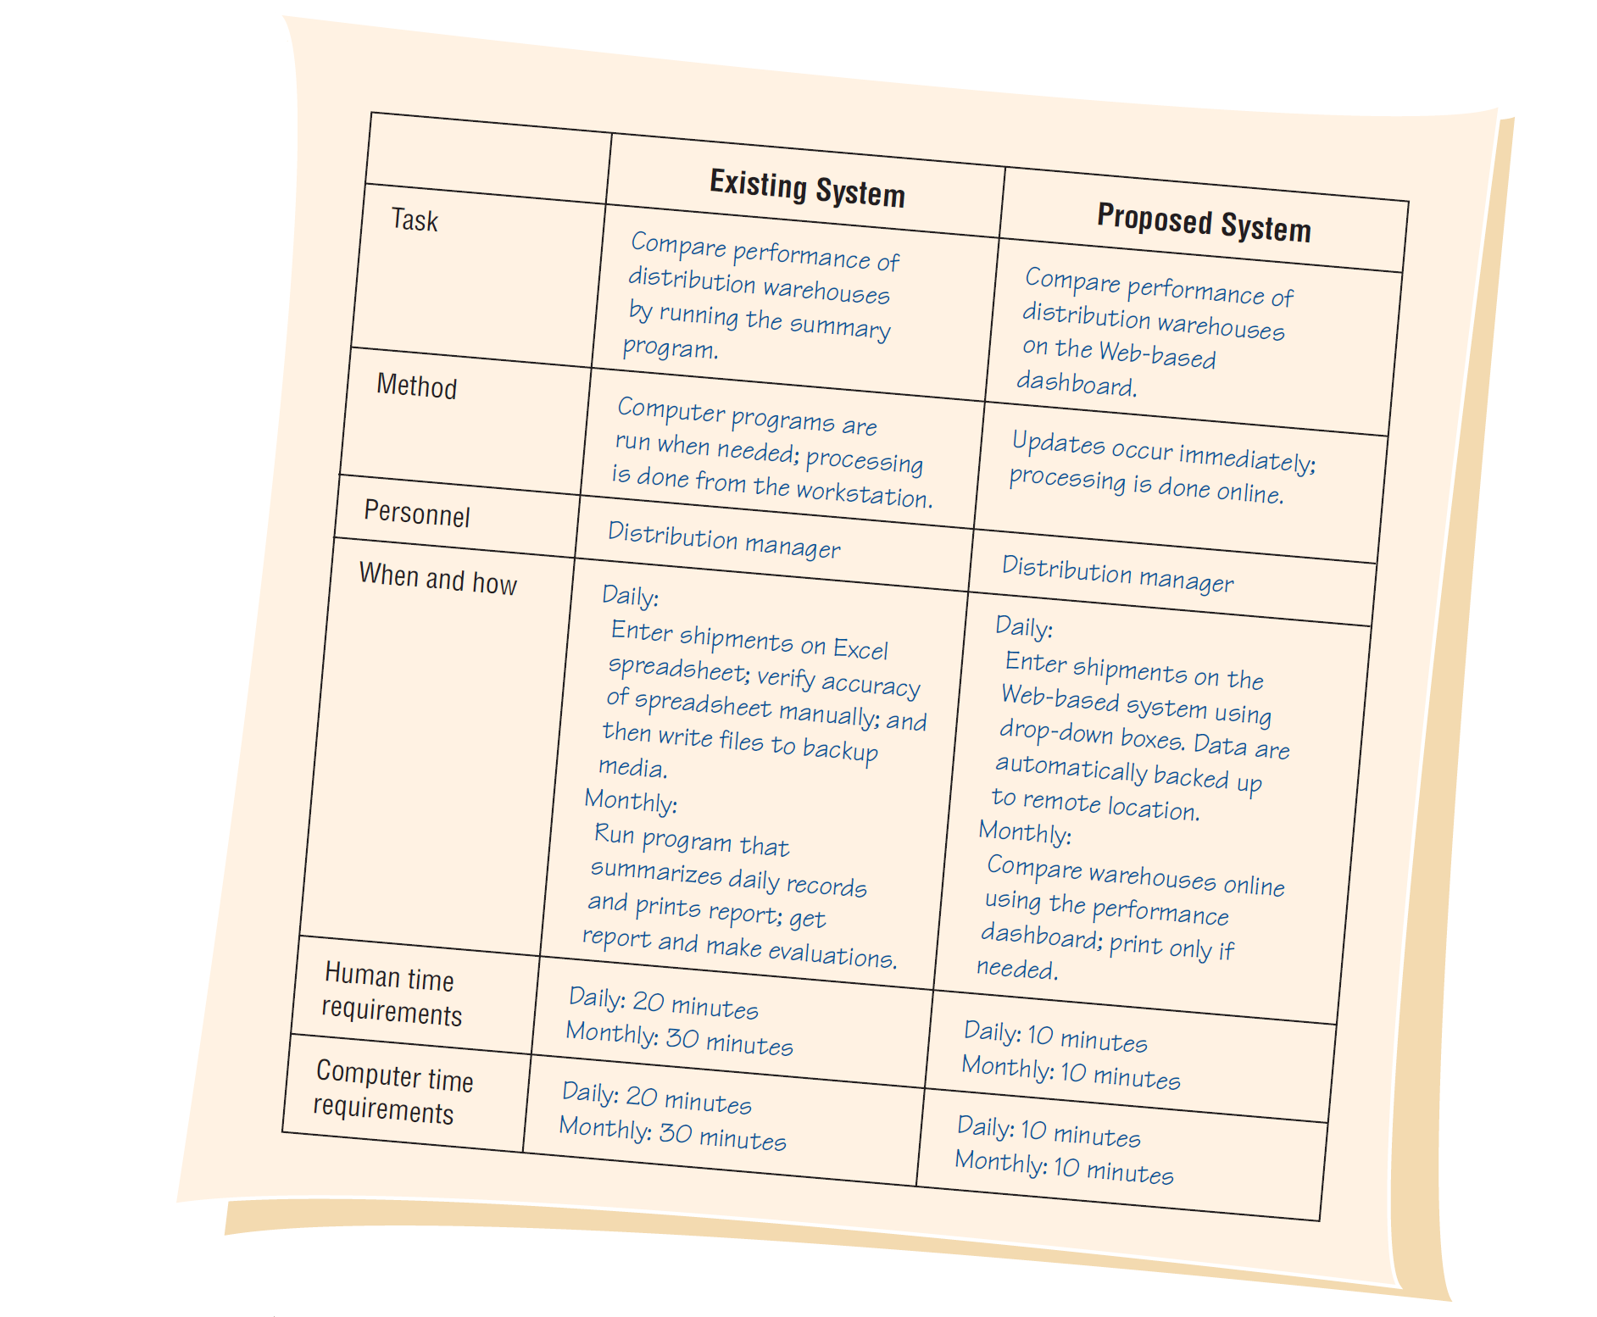
Comparisons of Workloads between Existing and Proposed Systems (Figure 3.4 )
3-<number>
Notes:
If estimates are accomplished properly, the business should not have to replace hardware solely due to unforeseen growth in system use.

Slide 18
Ascertaining Hardware and Software Needs
Steps used to determine hardware and software needs:
  Inventory computer hardware currently available
  Estimate current and future system workloads
  Evaluate available hardware and software
  Choose the vendor
  Acquire the computer equipment
3-<number>
Notes:
Only when systems analysts, users, and management have a good grasp of what kinds of tasks must be accomplished can hardware options be considered.

Slide 19
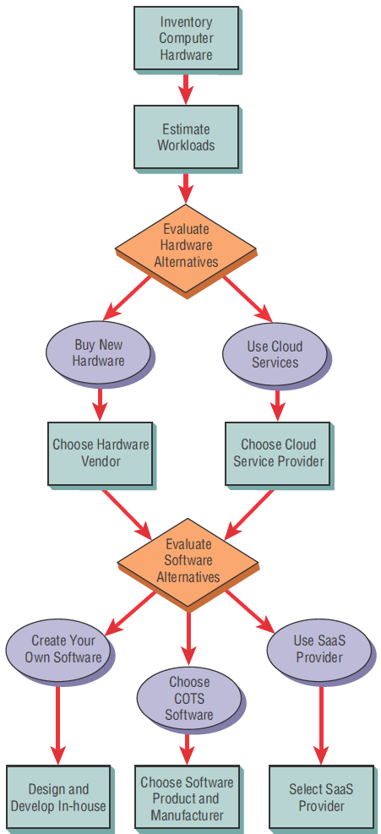
Steps in Choosing
Hardware and
Software (Figure 3.5)
3-<number>

Slide 20
Inventorying Computer Hardware
Type of equipment
Operation status of the equipment
Estimated age of equipment
Projected life of equipment
Physical location of equipment
Department or person responsible for equipment
Financial arrangement for equipment
3-<number>
Notes:
Begin by inventorying what computer hardware is already available in the organization.
Type of equipment—model number, manufacturer.
Operation status of the equipment—on order, in storage, in need of repair.
Financial arrangement for equipment—owned, leased, rented.

Slide 21
Evaluating Hardware
Time required for average transactions
Total volume capacity of the system
Idle time of the CPU or network
Size of memory provided
3-<number>
Notes:
Criteria that the systems analysts and users should use to evaluate performance of different systems hardware:
Time required for average transactions—including how long it takes to input data and how long it takes to receive output.
Total volume capacity of the system—how much can be processed at the same time before a problem arises.
Idle time of the CPU or network.
Size of memory provided.

Slide 22
People that Evaluate Hardware
Management
Users
Systems analysts
3-<number>
Notes:
Evaluating computer hardware is the shared responsibility of management, users, and systems analysts. Although vendors supply details about their offerings, analysts oversee the evaluation personally. Systems analysts will educate users and administration about advantages and disadvantages.

Slide 23
Available cloud services
Available cloud services may include:
  Web hosting
  Email hosting
  Application hosting
  Backup
  Storage and processing of databases
  Archiving
  Ecommerce
3-<number>

Slide 24
Three Main Categories of Cloud Computing
Software as a Service (SaaS)
Infrastructure as a Service (IaaS)
Platform as a Service (PaaS)
3-<number>

Slide 25
Strategic Cloud Computing Decisions
Decisions on cloud computing can first be addressed on a strategic level
Business should focus on:
  Define a high-level business case that focuses on high-level benefits
  Define core requirements
  Define core technologies for the enterprise
3-<number>

Slide 26
Benefits of Cloud Computing
Less time spent maintaining legacy systems
May be simpler to acquire IT services
Scalable applications that can grow by adding more cloud resources
Consistency across multiple platforms
Capital is not tied up
3-<number>

Slide 27
Drawbacks of Cloud Computing
Loss of control of data stored in the cloud
Potential security threats to data that is not stored on premises
Reliability of the Internet as a platform
3-<number>

Slide 28
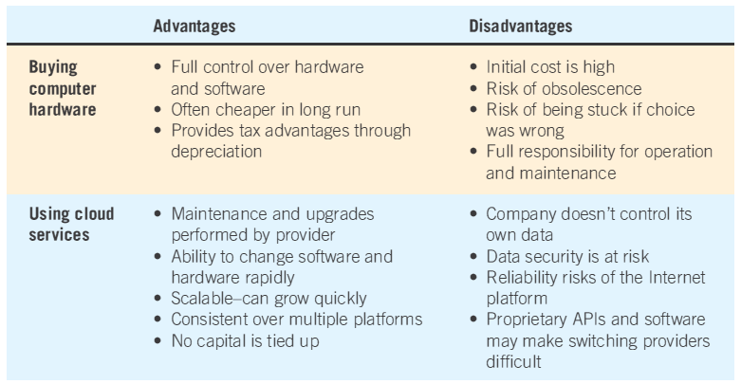
Purchasing or Using Cloud Services
Advantages and Disadvantages (Figure 3.6)
3-<number>
Notes:
Main determinants—projected life of the system.
As systems become smaller, more powerful, less expensive, and distributed systems become increasingly popular, more businesses are deciding to purchase equipment.

Slide 29
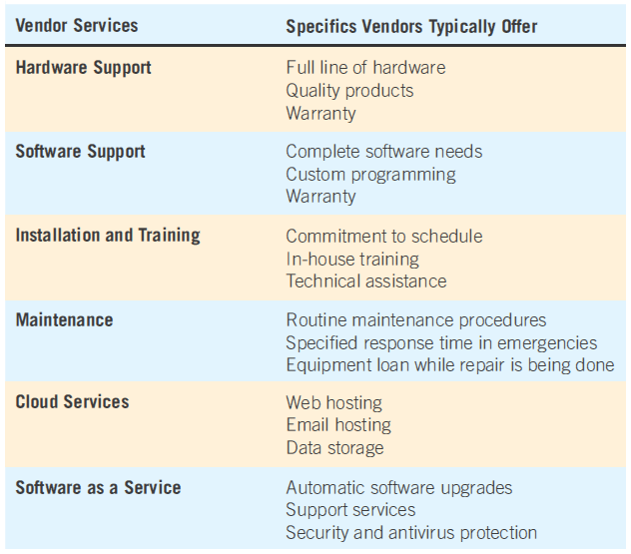
Guidelines for Vendor Selection (Figure 3.7)
3-<number>

Slide 30
BYOD and BYOT
BYOD: Bring your own device
BYOT: Bring your own technology
Employee uses their own device access corporate networks, data, and services remotely
3-<number>

Slide 31
Benefits of BYOD and BYOT
Building employee morale
Potential for lowering the initial cost hardware purchase
Facilitating remote, around-the-clock access to corporate computer networks
Building on a familiar user interface to access corporate computing services, applications, databases, and storage
3-<number>

Slide 32
Drawbacks of BYOD and BYOT
Security risks posed by untrained users
Loss of the device
Theft of the device and its data
Unauthorized access to corporate networks using personal mobile devices
3-<number>

Slide 33
Software Alternatives
Created custom software
Purchased as COTS (commercial off-the-shelf) software
Provided by an software as a service (SaaS)
3-<number>
Notes:
It is imperative to complete a human information requirements analysis of the users and the systems they use first.

Slide 34
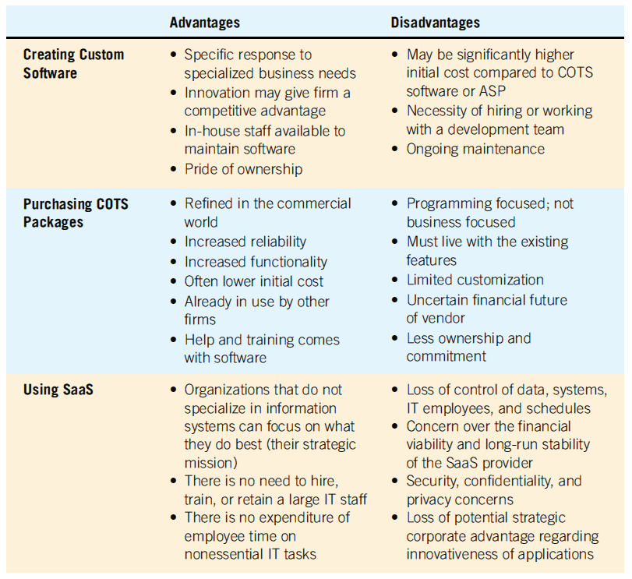
Software Alternatives
(Figure 3.8)
3-<number>

Slide 35
Software Evaluation
Performance effectiveness
Performance efficiency
Ease of use
Flexibility
Quality of documentation
Manufacturer support
3-<number>

Slide 36
Cash-Flow Analysis
Examines the direction, size, and pattern of cash flow that is associated with the proposed information system
Determines when cash outlays and revenues will occur for both; not only for the initial purchase, but over the life of the information system
3-<number>
Notes:
Cash-flow analysis is used to determine when a company will begin to make a profit and when it will be “out of the red.”

Slide 37
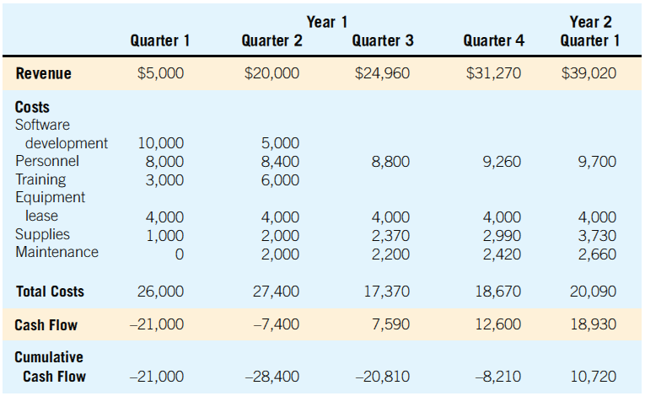
Cash-Flow Analysis for the Computerized Mail-Addressing System (Figure 3.12)
3-<number>

Slide 38
Work Breakdown Structure
Often a project needs to be broken down into smaller tasks or activities
These tasks together make up a work breakdown structure (WBS)
3-<number>

Slide 39
Work Breakdown Structure Properties
Each task or activity contains one deliverable, or tangible outcome, from the activity
Each task can be assigned to a single individual or a single group
Each task has a responsible person monitoring and controlling performance
3-<number>

Slide 40
Time Estimation Techniques
Relying on experience
Using analogies
Using three-point estimation
Identifying function points
Using time estimation software
3-<number>

Slide 41
Project Scheduling
Gantt Charts
  Simple
  Lends itself to end user communication
  Drawn to scale
PERT diagrams
  Useful when activities can be done in parallel
3-<number>

Slide 42
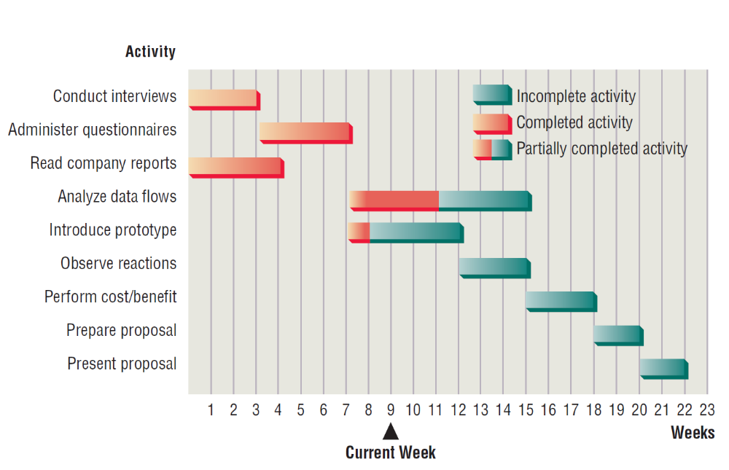
Using a Two-Dimensional Gantt Chart for Planning Activities that Can Be Accomplished in Parallel (Figure 3.18)
3-<number>

Slide 43
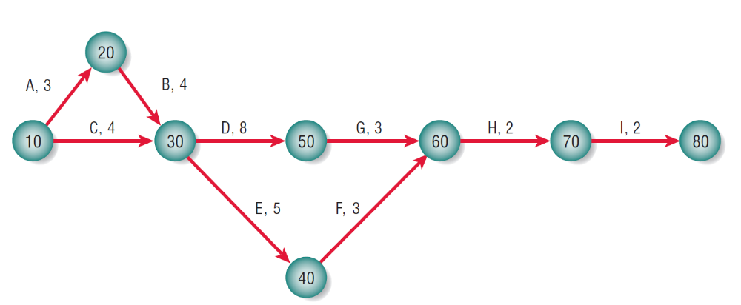
A Completed PERT Diagram for the Analysis Phase of a Systems Project (Figure 3.22)
3-<number>

Slide 44
PERT Diagram Advantages
Easy identification of the order of precedence
Easy identification of the critical path and thus critical activities
Easy determination of slack time
3-<number>

Slide 45
Estimating Costs
Using a work breakdown structure
  Estimate costs for each activity in the work breakdown structure
  Prepare a budget for the project and have it approved by the organization or client
  Manage and control the costs throughout the project
3-<number>

Slide 46
Approaches to Cost Estimation
Basing estimates on similar projects, also called the top-down approach
Building bottom-up estimates
Using parametric modeling
3-<number>

